Slide 1

OLIVIA NEWTON JOHN
TRIVIA

Slide 2
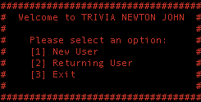
APP OVERVIEW
Educational Game
Entertainment Game
Challenge Friends
Notes:
Decided to create an educational game, with a little bit of fun added to it. Its based around naming capital cities around the world, hence the educational part, but with incredible graphics like this login screen, its also quite entertaining. We’ve also added features that allow the users to save their score, and compare it to others on a leaderboard

Slide 3
SWITCH THOSE BRAINS ON
TIME FOR OUR...LIVE WALK THROUGH!
Notes:
Go through features of app

Slide 4
BUILD PROCESS
Challenges
Creating a capitals database
Storing and accessing user details and high scores
Sending user details to quiz class
Notes:
For our MVP we created our own database, choosing 10 countries and capitals each. This was very timely, took heaps of code, and was hard to access. So after putting way too many hours into that, we found a JSON file on github that had all countries in the world. This wasn’t the end of it, as it had things like ‘Antartica’ and others whos capital was ‘nil’. So we had a quick scan and deleted the ones we didn’t like
After a bit of mucking about, we managed to get the username and score sent to the highscore final. This happened by asking user to confirm their username, which would obviously lead to alot of problems with typos and just general clunkiness. Accessing this however was a different story. We could get it, but it would print it all out...then print nothing. In the end, we turned the data into an array of hashes that we were able to loop through to print the scores out 1-by-1
We were able to set up our app, so a user had to be logged in, or registered before they could access the quiz. But we really struggled to get the data between classes...even went as far as trying global variables! In the end, we called a new instance of the class Quiz in our User class, and sent @username and @name across with it. When they got to the quiz class, we’d assign a value straight away, so we could access them in the rest of the class

Slide 5
Ethical Issues
Changing the spelling
Asunci
Asuncion
Notes:
Different countries spell cities in different ways. Take Paraguay for example. In Latin America, its spelt Asunci, whereas in Australia, is spelt Asuncion. This would obviously cause issues when a user would type an answer that is actually correct, but get the wrong result. The 2 ways around this were to add in a whole lot of “OR” statements, or just cop it, and change it to the Aussie spelling.
This poses an ethical issue as it subliminaly tells the youth of Australia that the English way is the correct way. After much debate however, we decided the ethical issue was not large enough to have a dysfunctioning app

Slide 6
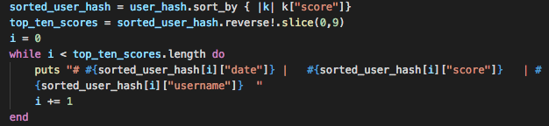
Favourite Parts
Hamish:
The sort, reverse and slice method on the leaderboard
Notes:
My lil’ baby. I’m sure its not actually that impressive a piece of code, but I had one of those mind blank moments and spent way too long on it.
Pretty much, the user_hash holds all the scores that have been added to the leaderboard file. By printing them out, they wouldn’t be in order, and the list would be as long as the amount of scores there were. So I set up a sorted hash, sorting by score. Reversed this array, and took the top ten values. Then looped through, printing out the time of the score, the actual score and which user got it

Slide 7
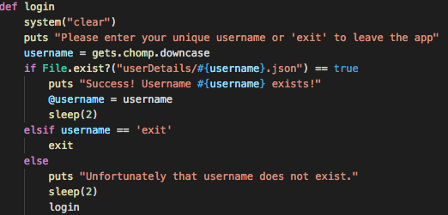
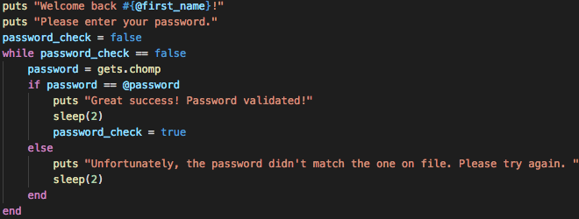
Favourite Parts
Ghalip:
The returning user aspect
Notes:
Ask for the user name, and then checks the files if there is user details to see the user exists,
If they exist, goes down to this functions, and if not, goes bank to login again,

Slide 8
Thank you!
Any Questions..

